Slide 1
Agenda
Asynchrony
Callbacks
Promises
async/await
Exercises
Assignment?

Slide 2
Asynchronous JavaScript
"Keep every promise you make and only make promises you can keep.”
- Anthony Hitt

Slide 3
Asynchrony: Now & Later

Slide 4
synchronous vs asynchronous
In a synchronous programming model, things happen one at a time. When you call a function that performs a long-running action, it returns only when the action has finished and it can return the result. This stops your program for the time the action takes.
An asynchronous model allows multiple things to happen at the same time. When you start an action, your program continues to run. When the action finishes, the program is informed and gets access to the result (for example, the data read from disk).

Slide 5
Callbacks

Slide 6
What is a Callback?
function onClick() {
// Simulate a code delay
setTimeout(() => {
console.log(1);
}, 500 );
}
document.addEventListener('click', onClick)
['a', 'b', 'c'].forEach(
x => console.log(a)
)
A callback function (say, Y) is a function that is passed to another function (say, X) as a parameter, and Y gets executed inside X.
JS uses callback functions to handle asynchronous control flow

Slide 7
Async callbacks
addEventListener()
XMLHttpRequest API/fetch
setTimeout()
setInterval()
requestAnimationFrame()

Slide 8
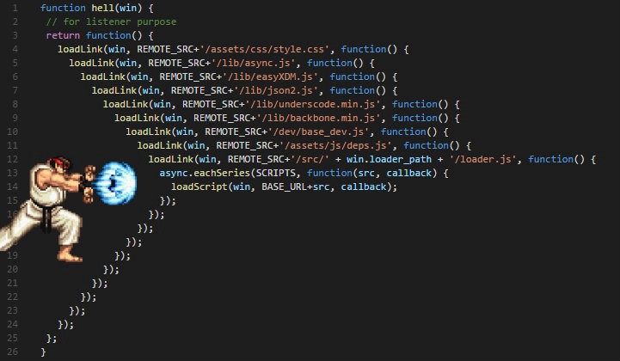
Callback hell
See the pyramid shape and all the }) at the end? Eek! This is affectionately known as callback hell.

Slide 9
Promises

Slide 10
The frustration
"JavaScript fatigue is what happens when people use tools they don't need to solve problems they don't have." –
Lucas F Costa

Slide 11
The reality
JavaScript is a synchronous programming language. But thanks to callback functions we can make it function like an asynchronous programming language.

Slide 12
What is a promise?
promise : noun : Assurance that one will do something or that a particular thing will happen.
Notes:
Promises in JavaScript are similar to the promises you make in real life, so let’s look at promises in real life.

Slide 13
So what happens when someone makes a promise to you ?
Notes:
Promises in JavaScript are similar to the promises you make in real life, so let’s look at promises in real life.

Slide 14
1. A promise gives you an assurance that something will be done.
Whether they (who made the promise) will do it themselves or they get it done by
others is immaterial.
They give you an assurance, based on which you can plan something.
Notes:
Promises in JavaScript are similar to the promises you make in real life, so let’s look at promises in real life.

Slide 15
2. A promise can either be kept or broken.
Notes:
Promises in JavaScript are similar to the promises you make in real life, so let’s look at promises in real life.

Slide 16
3. When a promise is kept you expect something out of that promise.
You can make use of the output of a promise for your further actions or plans.
Notes:
Promises in JavaScript are similar to the promises you make in real life, so let’s look at promises in real life.

Slide 17
4. When a promise is broken, you want to know why (reason) the person who
made the promise wasn’t able to keep up his side of the bargain.
Once you know the reason, and have a confirmation that the promise has been
broken, you can plan what to do next.
Notes:
Promises in JavaScript are similar to the promises you make in real life, so let’s look at promises in real life.

Slide 18
5. When a promise is made to us all we have is an assurance.
We can’t act on it immediately.
We can decide and formulate what needs to be done when the promise is
kept (hence we have an expected outcome)
or broken (we know the reason and hence we can plan a contingency).
Notes:
Promises in JavaScript are similar to the promises you make in real life, so let’s look at promises in real life.

Slide 19
There are two parts to understanding promises.
Creating promises and handling promises.
Although most of our code will cater to handling promises created by other
libraries, gaining a complete understanding is important.
Understanding the creation of promises will be increasingly important as you
advance from the beginner stage.
Notes:
Promises in JavaScript are similar to the promises you make in real life, so let’s look at promises in real life.

Slide 20
What Is a Promise?
new Promise(function(resolve, reject) {
console.log('Initial');
resolve();
})
.then(function() {
throw new Error('Something failed');
console.log('Do this');
})
.catch(function() {
console.error('Do that');
})
The Promise object represents the eventual completion (or failure) of an asynchronous operation, and its resulting value.

Slide 21
Creating a promise
new Promise( /* executor */ function(resolve, reject) { ... } );
The constructor accepts a function called executor. This executor function accepts two parameters: resolve and reject, which are in turn functions.

Slide 22
Creating a promise
Promises are generally used for easier handling of asynchronous operations or blocking code, for example, file operations, API calls, DB calls, IO calls, etc.
These asynchronous operations initiate inside the executor function. If the asynchronous operations are successful the expected result is returned by calling the resolve function. Similarly, if there was some unexpected error the reasons are passed on by calling the reject function.

Slide 23
Creating a promise
Now we know how to create a promise. Let’s create a simple promise to help our understanding.
var keepsHisWord; keepsHisWord = true; promise1 = new Promise(function(resolve, reject) { if (keepsHisWord) { resolve("The man likes to keep his word"); } else { reject("The man doesnt want to keep his word"); } }); console.log(promise1);

Slide 24
Creating a promise
promise2 = new Promise(function(resolve, reject) { setTimeout(function() { resolve({ message: "The man likes to keep his word", code: "aManKeepsHisWord" }); }, 10 * 1000); }); console.log(promise2);

Slide 25
Creating a promise
keepsHisWord = false; promise3 = new Promise(function(resolve, reject) { if (keepsHisWord) { resolve("The man likes to keep his word"); } else { reject("The man doesn't want to keep his word"); } }); console.log(promise3);

Slide 26
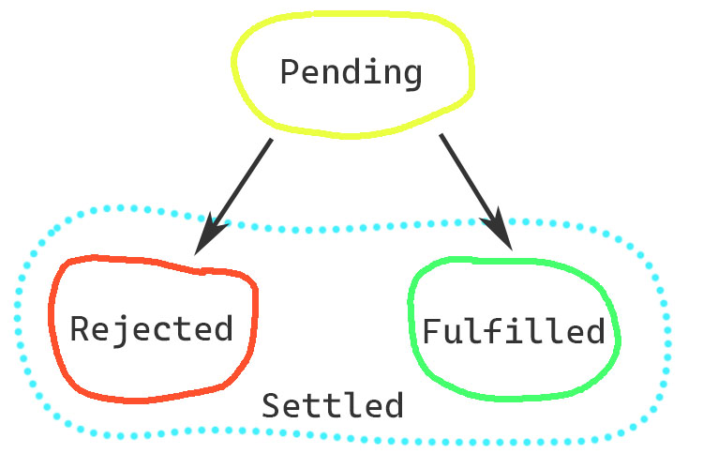
Promise states
pending: initial state, neither fulfilled nor rejected.
fulfilled: meaning that the operation completed successfully.
rejected: meaning that the operation failed.

Slide 27
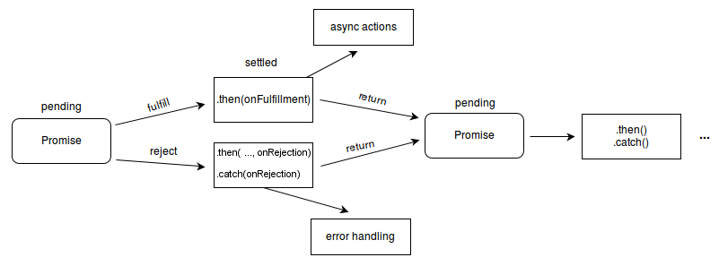

Slide 28
Guarantees
Callbacks will never be called before the completion of the current run of the JavaScript event loop.
Callbacks added with then(), as above, will be called even after the success or failure of the asynchronous operation.
Multiple callbacks may be added by calling then() several times. Each callback is executed one after another, in the order in which they were inserted.

Slide 29
then Method
promise.then(
onFulfilled?: Function,
onRejected?: Function
) => Promise
then sets onFulfilled and onRejected functions as handlers for our promise.

Slide 30
Chaining
doSomething()
.then(function(result) {
return doSomethingElse(result);
})
.then(function(newResult) {
return doThirdThing(newResult);
})
.then(function(finalResult) {
console.log('Got the final result: ' + finalResult);
})
the then() function returns a new promise, different from the original:

Slide 31
Error propagation
doSomething()
.then(
result => doSomethingElse(result),
error => console.log(error)
)
.then(
newResult => doThirdThing(newResult)
)
.catch(failureCallback)
If there's an exception, the browser will look down the chain for .catch() handlers or onRejected.

Slide 32
Creating a Promise around an old callback API
const wait = ms =>
new Promise(
resolve => setTimeout(resolve, ms)
);
wait(10*1000)
.then(
() => saySomething("10 seconds")
)
.catch(failureCallback);

Slide 33
Composition
Promise.reject('error')
.then(value => console.log(value))
.catch( error => console.log(error))
Promise.all([ func1(), func2(), func3()])
.then(
([result1, result2, result3]) => {
/* use result1, result2, result3 */
}
);

Slide 34
Timing
Promise.resolve()
.then(
() => console.log(2)
);
console.log(1);
To avoid surprises, functions passed to then() will never be called synchronously, even with an already-resolved promise:

Slide 35
async/await

Slide 36
What is async/await?
async function main () {
const result1 = await new Promise(
resolve => setTimeout(() => resolve('async await'))
)
console.log(result1)
};
main()
Async: special function that returns a promise
Await: pauses execution of an async function

Slide 37
Error handling
async function main() {
try {
let response = await fetch('http://...');
}
catch(err) {
alert(err);
// TypeError: failed to fetch
}
}
main();
If a promise resolves normally, then await promise returns the result. But in the case of a rejection, it throws the error, just as if there were a throw statement at that line.

Slide 38
Excellent Bio
https://web.dev/promises/
https://blog.domenic.me/youre-missing-the-point-of-promises/
https://medium.com/dailyjs/javascript-async-await-zero-to-hero-plus-cheat-sheet-4b064401e29a

